Slide 1

SMART INDIA HACKATHON 2026
SAHYOG
Problem Statement ID – SIH26089
Problem Statement Title- Cooperative Gig Services Platform for Household & Community Services
Theme- Agriculture, FoodTech & Rural Development
PS Category- Software
Team ID- 123233
Team Name- BugSquad

Slide 2
SAHYOG
BugSquad
India's 1st Cooperative-Owned Digital Service Marketplace & Welfare Platform
The Problem & Market Gap
Our Solution (How It Works)
Innovation & Uniqueness
Key Value Propositions
• Commercial Aggregator Exploitation: Private platforms deduct 20–30% commissions without offering social safety nets or worker ownership.
• Underutilized Cooperative Network: Millions of skilled trade workers in Labour Cooperatives (LCCs) lack a structured digital gateway to reach local urban and rural demand.
• Trust & Verification Deficit: Consumers struggle to find verified, police-cleared, and skill-certified technicians for urgent home services.
• Cooperative-First Digital Marketplace: Connects Primary Labour Cooperative Societies directly with households, enterprises, and institutions.
• Full Lifecycle Service Engine: Real-time map-based discovery, emergency SOS booking, live status tracking, and automated digital invoicing.
• Multi-Tier Institutional Verification: Rigorous onboarding pipeline (Society KYC → NCCT/NSDC Skill Certification → Background Check).
• Fair 88-7-5 Cooperative Split: Split: 88% directly to the worker, 7% to a Cooperative Welfare & Insurance Fund (PMSBY/PM-SYM), and only 5% for platform maintenance.
• Explainable 4-Factor Matching Engine: Transparent algorithmic allocation based on Skill (40%), Proximity (30%), Availability (20%), and Workload (10%).
• 3-Tier Governance Hierarchy: Role-specific portals for Primary Societies, State Federations (LABCOFED), and Ministry/NCCT oversight dashboards.
• For Workers: Guaranteed minimum wage standards, direct UPI payouts, accident insurance, and institutional upskilling via NCCT.
• For Consumers: Verified local technicians, standardized pricing, transparent deterministic matching, and rapid emergency dispatch.
• For Cooperatives & Govt: Complete data visibility into regional labour demand, worker utilization, and digital compliance under the "Sahkar-se-Samriddhi" vision.
🏠 📍 👷 💳 🤝
CUSTOMER ───→ SMART MATCH ───→ VERIFIED ───→ SETTLEMENT ───→ COOPERATIVE
NEED WORKER
WebApp Link : https://sahyogapp.vercel.app/
GitHub Repo link : https://github.com/sagnikdevelops/Sahyog
Demo Video Link :

Slide 3
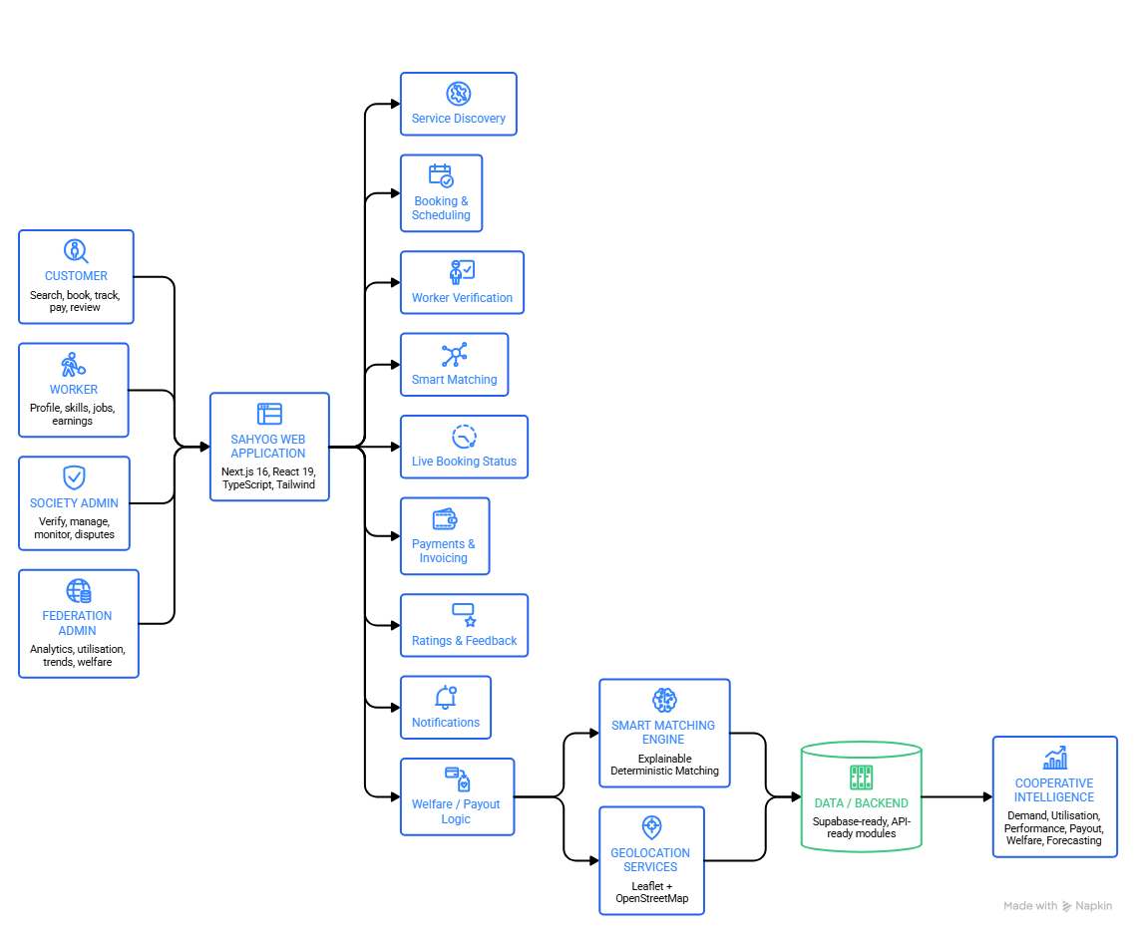












TECHNICAL APPROACH
BugSquad
System Architecture
Service Discovery (Trade & Urgency selection)
PostGIS Geo-Match (Top 3 workers alerted)
Worker Accept (Live ETA & profile shared)
OTP Job Start (Secure site verification)
Proof-of-Work Upload (Geo-tagged photo)
Digital Invoice & 88/7/5 Automated Escrow Split.
Methodology
&
Process
Tech Stack
Frontend
UI
Backend
Database
Maps
Auth
Deployment

Slide 4
FEASIBILITY AND VIABILITY
BugSquad
Analysis of the feasibility of the idea
Potential challenges, Risks & Mitigations
Potential challenges, Risks & Mitigations
Technical Feasibility: Built entirely on production-proven open-source technologies (Next.js, PostgreSQL, PostGIS); achieves sub-second geo-queries; live working webapp deployed with zero proprietary hardware requirements.
Operational Feasibility: Plugs directly into the existing network of 48+ Labour Cooperative Federations and primary societies in India; Society Admins act as localized onboarding, verification, and support hubs.
Regulatory & Policy Alignment: Fully compliant with Multi-State Cooperative Societies Act and Ministry of Cooperation digital mandates; natively integrates Pradhan Mantri Suraksha Bima Yojana (PMSBY) for worker accident insurance.
Sustainable Unit Economics: 88% direct to worker (financial empowerment) | 7% dedicated to Cooperative Welfare & Accident Fund | 5% platform fee (fully covers cloud hosting, map APIs, and ops without external debt).
Risk 1 – Digital Literacy Among Informal Workers: Mitigation: Society supervisor assisted onboarding; vernacular Hindi/English UI with visual trade icons, SMS/WhatsApp dispatch alerts, and planned voice prompts.
Risk 2 – Customer Trust & Safety in Households: Mitigation: 3-Tier Verification (Govt ID + ITI/NSDC certificate + Society physical vetting badge) + mandatory 4-digit OTP exchange upon site arrival.
Risk 3 – Worker No-Show / Service SLA Delays: Mitigation: Automated cascading re-dispatch to backup workers after 2-minute timeout; reliability score penalties for unnotified cancellations.
Risk 4 – Demand-Supply Volatility:
Mitigation: AI-based seasonal surge heatmaps alert Federations to proactively mobilize, train, and cross-deploy workers in high-demand clusters.

Slide 5
IMPACT AND BENEFITS
BugSquad
Verified Workers
1,500+ verified workers onboarded to the
platform
Total Bookings
QUANTIFIABLE YEAR 1 PROJECTIONS & OUTCOMES
12,000+ household and institutional
bookings completed
Cooperative Societies
48+ labour cooperative societies connected
to the network
Welfare Fund
₹15+ lakhs accident and welfare fund
corpus generated
Skilled Workers | Cooperatives Labour | Households & Consumers | Government & Cooperatives
30–40% increase in net take-home earnings, digital financial inclusion, formal work history, and guaranteed accident insurance. | Complete digital transformation from paper registries to live GIS workforce tracking dashboards, automated bookkeeping, and aggregated institutional B2B maintenance contracts. | Access to verified, police/society-vetted local tradespeople at transparent standardized rates (zero surge gouging), with a 30-minute rapid emergency response target. | Direct realization of Ministry of Cooperation’s "Sahakar se Samriddhi" mandate, formalizing the unorganized gig economy and integrating workers into national safety nets.
Emergency Dispatch
<30 min emergency dispatch service level
agreement
BROADER MULTI-DIMENSIONAL BENEFIT
Social Benefits: Restores dignity of labor, provides social security (PMSBY), and builds verified digital credit profiles for unorganized workers.
Economic Benefits: Wealth retention within the cooperative ecosystem; prevents value extraction by private multinational aggregators.
Environmental Benefits: Hyperlocal PostGIS matching connects nearest proximate workers, reducing transit distances and urban vehicular emissions.

Slide 6




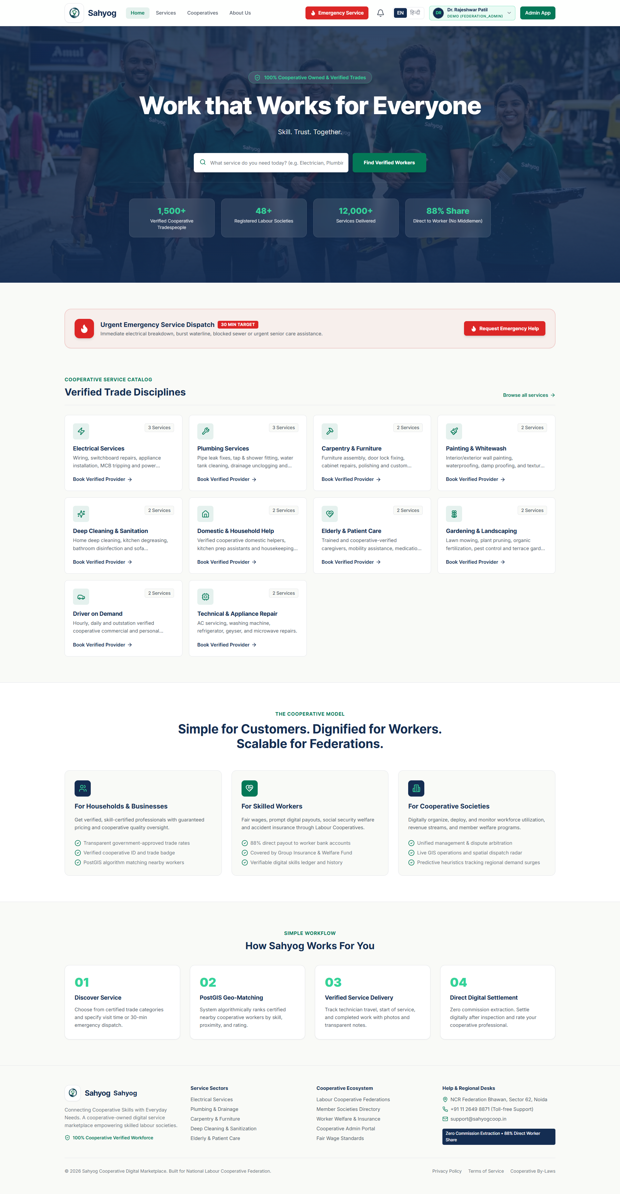
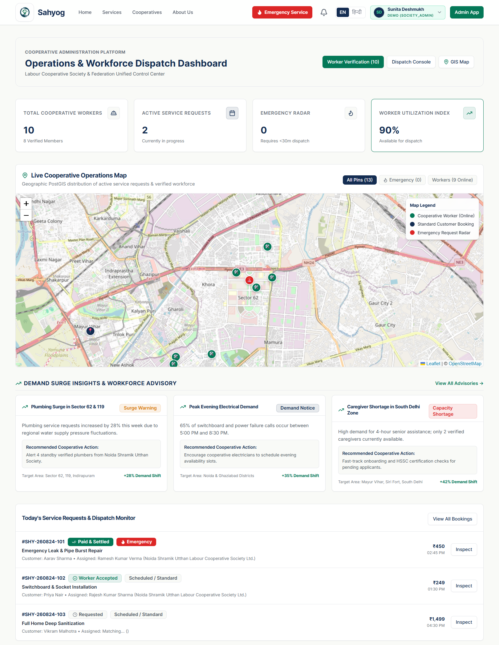
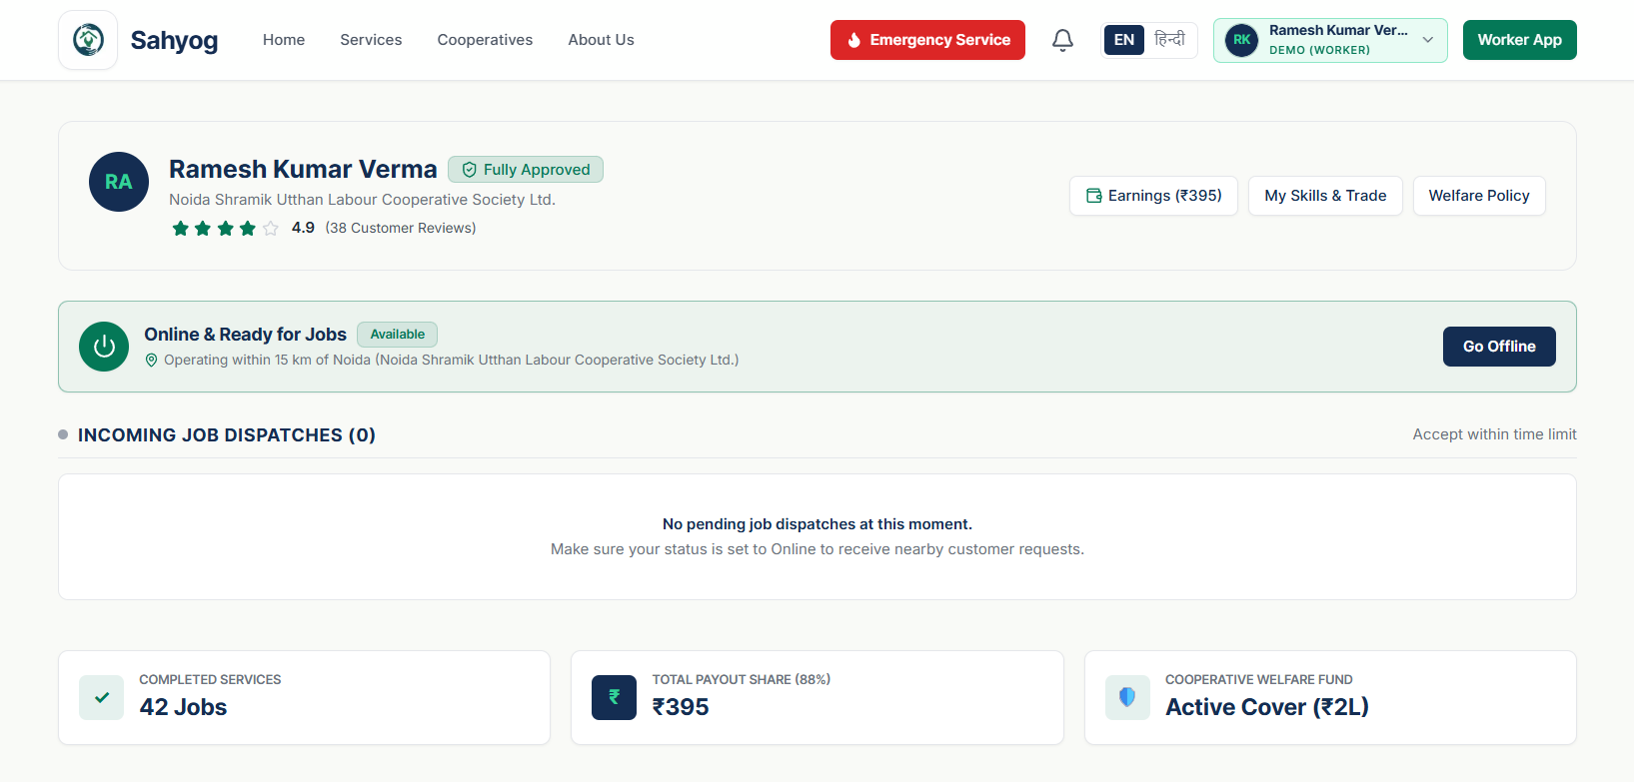
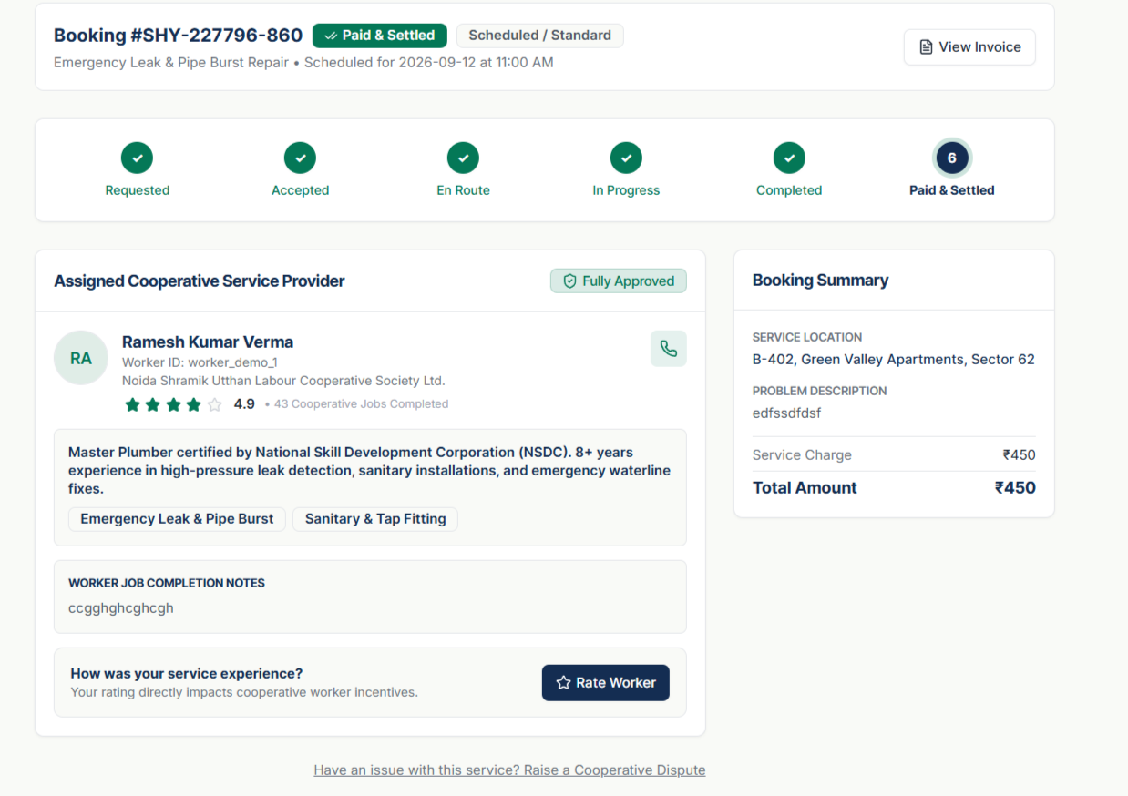
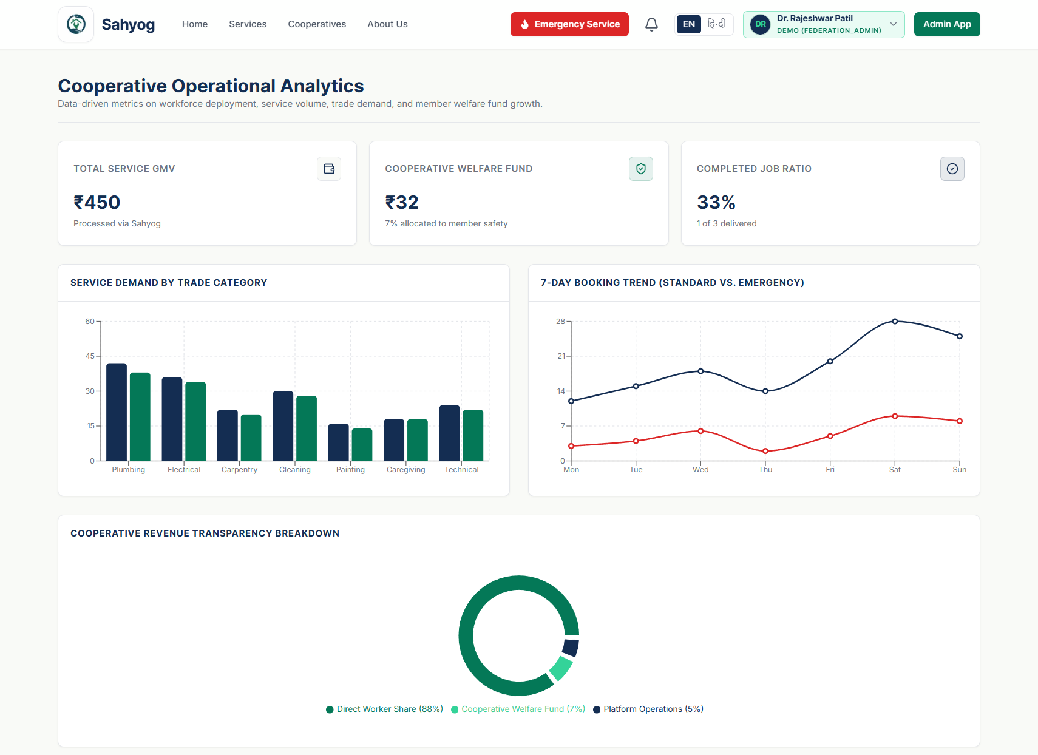
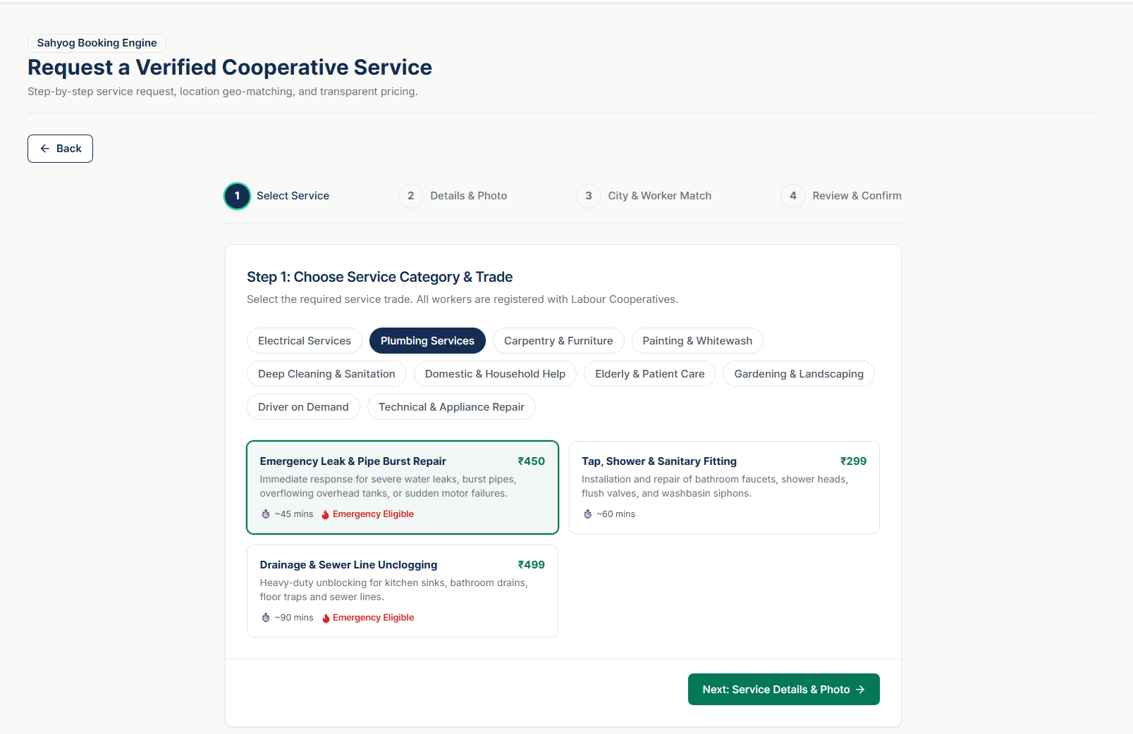
RESEARCH AND REFERENCES
BugSquad
NITI Aayog (2022) — India’s Booming Gig and Platform Economy
7.7M gig workers → 23.5M projected by 2029–30
LINK
National Cooperative Union of India
It publishes the Indian Cooperative Review, a peer-reviewed quarterly containing research articles and case studies on India's cooperative movement, and maintains cooperative statistical resources.
LINK
Ministry of Cooperation — National Cooperative Database
8.5 lakh cooperatives mapped through a unified digital database
LINK
Ministry of Labour & Employment
Supports the need for structured social-security and welfare mechanisms for platform workers
LINK

